Slide 1
Search Engine Optimization(SEO)

Slide 2


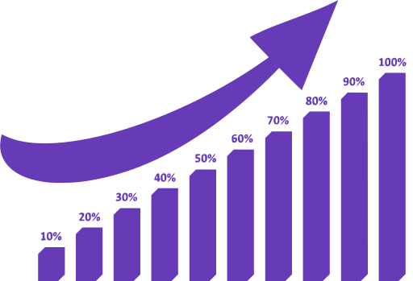
How Search Engine Work?
Web pages
Crawler
(Spider)
Local Server
Ranking
Indexer
(categories)

Slide 3
Types of SEO
ON-PAGE
SEO
OFF-PAGE
SEO

Slide 4
On Page SEO
SEO-friendly URL Structure
Meta keyword
Optimized Meta Descriptions (150-160 character) & Title Tags (50-60 character)
Image (alt)
Heading
Internal Linking

Slide 5
Technical SEO
Load time
Redirect pages
Sitemap
Structure of website
Mobile Friendly

Slide 6
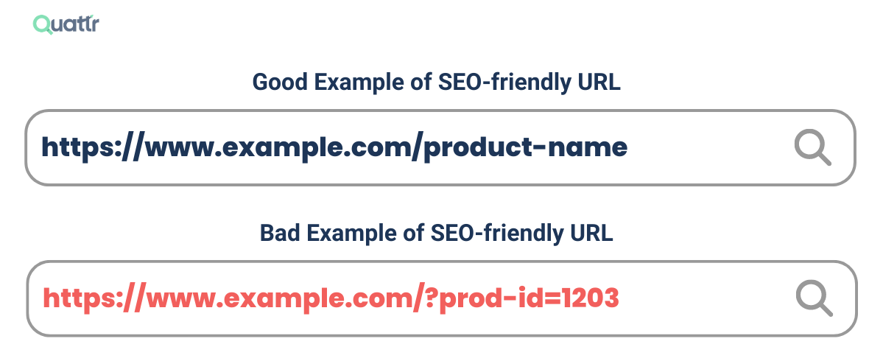
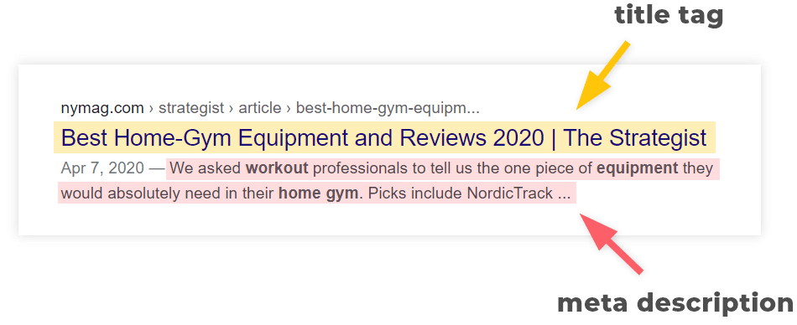
URL Sturucture
Meta
Description

Slide 7
OFF Page SEO
Building High-Quality Backlinks
Social Media Engagement (ads)
Domain Authority

Slide 8
TECHNIQUES of SEO
Black Hat
SEO
White Hat
SEO
Gray Hat SEO

Slide 9

White Hat
Strategies
Quality content
Keyword planing
Organic SEO
Better UX (user experience)

Slide 10

Black Hat
Strategies
Duplicate content
Keyword Stuffing
Cloaking (Mask)
Hidden test/ links

Slide 11

Keyword
It’s the word or phrase for which you want a specific page to rank
Short-tail keyword:
General keywords. Use for general query
For example: Story book
Long-tail keyword:
Specific keyword. Use for specific query
For example: Moral story book for kids,
Moral story books in english

Slide 12
Common SEO Mistakes to Avoid
Keyword Stuffing & Over-Optimization
Ignoring Mobile Optimization
Poor Website Speed
Lack of High-Quality Backlinks
Duplicate Content Issues

Slide 13
THANK YOU

